Slide 1
Who Needs Batch?
By Michael Minella and Gunnar Hillert
@michaelminella, @ghillert

Slide 2



Slide 3
Gunnar Hillert
Twitter: @ghillert
Website: http://blog.hillert.com
Conference: http://devnexus.com
Michael Minella
Twitter: @michaelminella
Podcast: http://javaOffHeap.com
or @OffHeap
Website: http://spring.io

Slide 4


Slide 5

https://github.com/ghillert/s1-2gx2015-who-needs-batch

Slide 6

WE HAVE AN
ANNOUNCEMENT

Slide 7


WE HAVE A
DISEASE

Slide 8
OBJECTIVIUS SHINIUM
SYNDROMUS

Slide 9

SHINY OBJECT
SYNDROME
Shiny Object Syndrom

Slide 10

IT MAKES US
INNOVATE

Slide 11

ROAD TO
RECOVERY

Slide 12

COOL KIDS ARE DOING
STREAM PROCESSING

Slide 13














Stream Analytics
Cloud Dataflow
Notes:
Apache Flink
Stream Analytics on Azure
Google Cloud Dataflow
EBay’s Pulsar
Tigon – Tigon.io

Slide 14
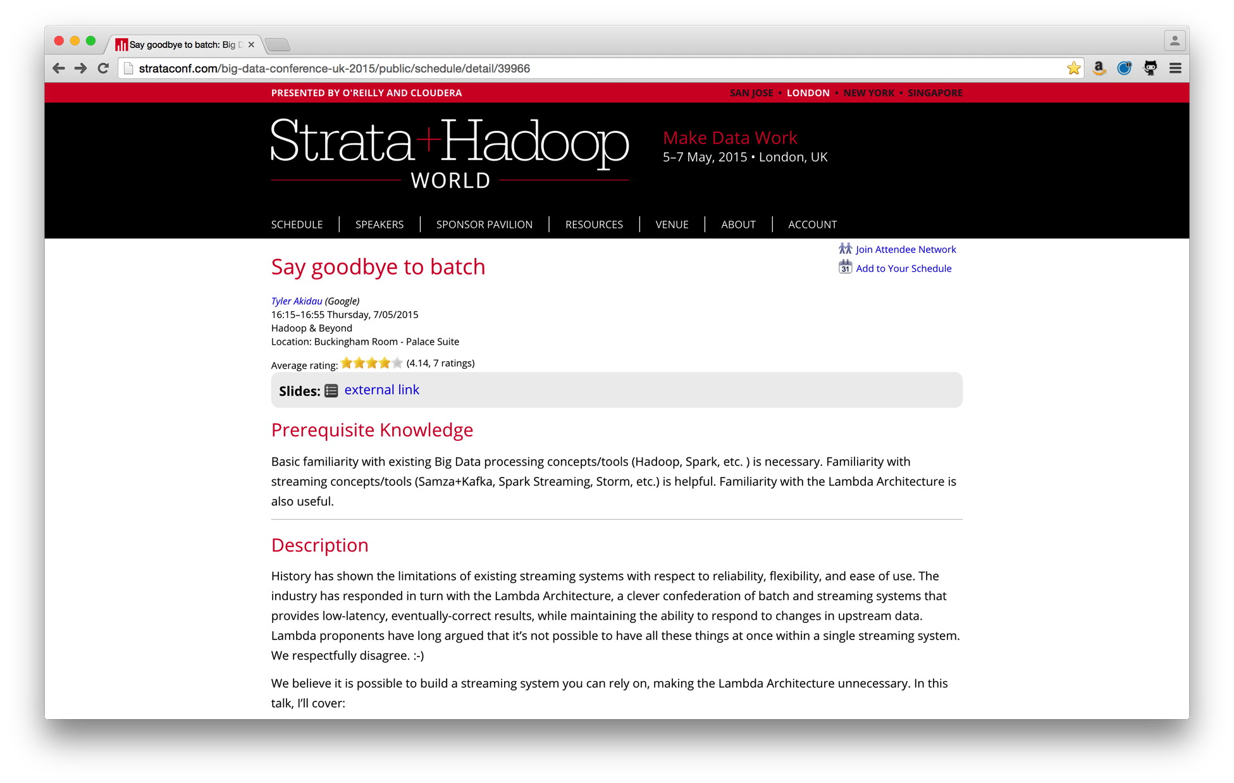

Slide 15

Notes:
Batch processing has been around since the beginning (ENIAC)

Slide 16

LET’S TAKE A
CLOSER LOOK

Slide 17
Notes:
Introductions

Slide 18

BATCH AND STREAM
DEFINITIONS

Slide 19

LOOK AT COMMON
USE CASES

Slide 20

CONCLUSIONS

Slide 21

DEFINITION:
STREAM PROCESSING

Slide 22
A system for processing an unbounded
set of data in an asynchronous manor.

Slide 23
DEFINITION:
BATCH PROCESSING

Slide 24

DEPENDS ON
WHO YOU ASK

Slide 25
“Batch … applications run … as special
cases of stream processing applications”
- Apache Flink Documentation

Slide 26
Batch processing is the processing of
a bounded data set without interruption
or interaction

Slide 27

KEY
DIFFERENCES

Slide 28
1
BOUNDED VS
UNBOUNDED

Slide 29
2
SYNCHRONOUS VS
ASYNCHRONOUS

Slide 30
3
STATEFUL VS
STATELESS

Slide 31

STATE OF
STREAMING

Slide 32
Stream Analytics
Cloud Dataflow
Notes:
Apache Flink
Stream Analytics on Azure
Google Cloud Dataflow
EBay’s Pulsar
Tigon – Tigon.io

Slide 33
Stream Analytics
Cloud Dataflow
Notes:
Apache Flink
Stream Analytics on Azure
Google Cloud Dataflow
EBay’s Pulsar
Tigon – Tigon.io

Slide 34
STATE OF
BATCH

Slide 35






JSR-352

Slide 36
WHY THE
END OF BATCH?

Slide 37

LATENCY

Slide 38
WHAT DOES THE
END OF BATCH MEAN?

Slide 39
LIMIT
LATENCY

Slide 40

“ENTERPRISE GRADE”
Notes:
Error handling
Integration with existing systems

Slide 41
LOOK AT COMMON
USE CASES

Slide 42

E.T.L.

Slide 43



DATABASE TO HDFS

Slide 44

DEMO

Slide 45
APACHE FLINK
Hadoop
Table
ML
Dataflow
…
Table
Dataflow
…
DataSet API (Batch)
DataStream API
Streaming Dataflow Runtime
Local
Remote
Yarn
Tez
Embedded
Notes:
Streaming Dataflow Engine
Unified Stream & Batch Processing
Apis for Scala, Java, Python
Leverages Akka
Formerly known as Stratosphere
Started as a research Project by 3 German universities in 2010
http://flink.apache.org/

Slide 46
STREAMING CAN BE USEFUL
IN INGESTION USE CASES

Slide 47

TWITTER TO HDFS

Slide 48

DATA SCIENCE

Slide 49

BATCH TRAINING
PREDICTIVE MODELS

Slide 50

CONNECTED
CAR
Notes:
Everyone is familiar with a car

Slide 51


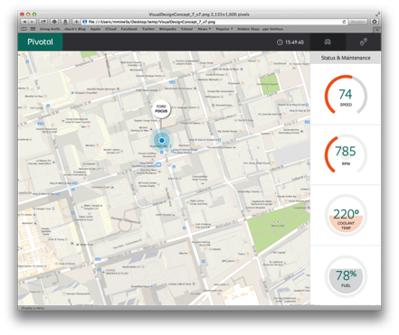
http
filter
transformer
python
hdfs
spark
Hadoop
type-transformer
Gemfire
REST
Gemfire

Slide 52
≈
STREAMING
APROXIMIATIONS EXIST

Slide 53
≠
BREADTH AND ACCURACY
DON’T MATCH BATCH

Slide 54

WORKFLOW
ORCHESTRATION

Slide 56
start
getDirectoryInfo
forEachDir
…
dirSubProcss
dirSubProcss
join

Slide 57
start
getDirAgeAndNumberOfFiles
Condition 1
Condition 2
sendReminderEmail
Ingest
End
Archive
Notes:
Condition 1
Directory does not exist || (Directory.age < 1 && Directory.numberOfFiles < 24)
Condition 2
Directory.numberOfFiles > 23 || Directory.age > 6

Slide 58

DEMO

Slide 59
HOW IS THIS DONE
VIA STREAMING?

Slide 60
NON-INTERACTIVE
PROCESSING

Slide 61

SAME AS ETL
PROCESSING

Slide 62

PORT SCANNER

Slide 63

DEMO

Slide 64
STREAMING
DOESN’T MAKE SENSE

Slide 65
STREAMING
DOES MAKE SENSE

Slide 66
WHERE LATENCY
IS A PRIORITY

Slide 67

DATA LOSS
IS ACCEPTABLE

Slide 68

UNBOUNDED
DATASET

Slide 69
BUT DOES NOT
IN OTHER USE CASES

Slide 70

HIGHLY
COMPLEX
Notes:
Need a cluster to run in production
Different toolset

Slide 71

ERROR HANDLING
NOT AS ROBUST

Slide 72

DATA GUARANTEES
NOT AS ROBUST

Slide 73
WHERE BATCH
IS BETTER

Slide 74

FINITE
DATASET

Slide 75
ROBUST
ERROR HANDLING

Slide 76

DATA GUARANTEES
BATTLE TESTED

Slide 77
BATCH LOGO SLIDE?

Slide 78

RESOURCES
ARE A CONCERN

Slide 79


NOT EITHER OR

Slide 80

COMBINING THE TWO
PROVIDES THE MOST POWER

Slide 81
E.T.L.v2

Slide 82
Database to HDFS v2
http
mysql2hdfs
mail

Slide 83

DEMO

Slide 84

CONSISTENT
PROGRAMMING MODEL

Slide 85

SHARE CODE
BETWEEN PARADIGMS

Slide 86
Notes:
Batch processing has been around since the beginning (ENIAC)

Slide 87

BATCH HAS LASTED
BECAUSE IT MAKSE SENSE

Slide 88

SPRING XD/DATA FLOW
BEST OF BOTH WORLDS

Slide 89
ENTERPRISE GRADE
STREAM PROCESSING

Slide 90
BEST BATCH OPTION
ON THE JVM

Slide 91


Slide 92



Learn More. Stay Connected.
@springcentral
Spring.io/video
Check out Spring Cloud Data Flow on https://spring.io
Apache Spark for Big Data Processing – Salon N-P Up next!
High Performance Stream Processing – Salon N-P 8:30AM Tomorrow
Spring Integration Extensions Ecosystem – Here! 12:45 Tomorrow

